Slide 1
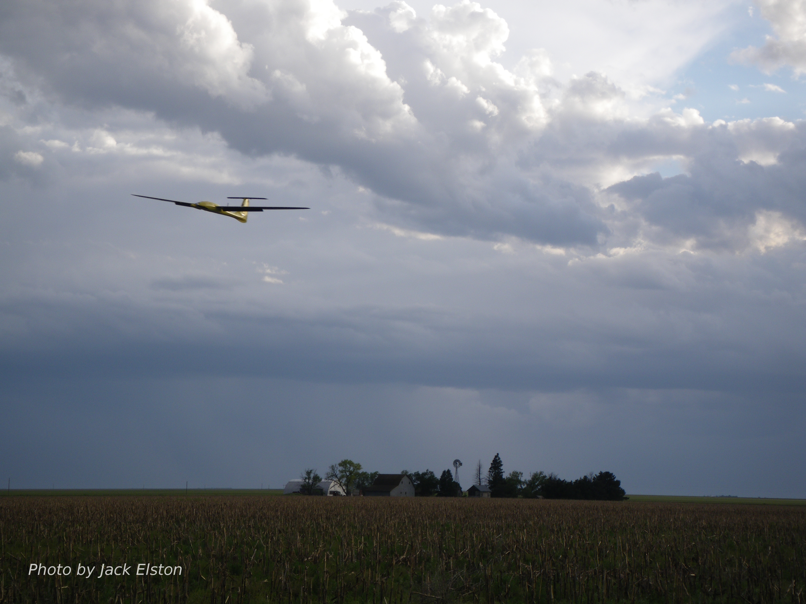
Chapter 4
Forces and Moments

Slide 2
Architecture

Slide 3
Equations of Motion from Chap 3
System of 12 first-order ODE’s
Notes:
\newcommand{\sth}{\text{s}_\theta}
\newcommand{\cth}{\text{c}_\theta}
\newcommand{\sph}{\text{s}_\phi}
\newcommand{\cph}{\text{c}_\phi}
\newcommand{\sps}{\text{s}_\psi}
\newcommand{\cps}{\text{c}_\psi}
\newcommand{\mass}{\mathsf{m}}
\newcommand{\Vbf}{\mathbf{V}}
\newcommand{\defeq}{\stackrel{\triangle}{=}}
The combined equations of motion from Chapter 3 are
\begin{align*}
\begin{pmatrix} \dot{p}_n \\ \dot{p}_e \\ \dot{p}_d \end{pmatrix}
&= \begin{pmatrix} \cth \cps & \sph \sth \cps - \cph \sps
& \cph \sth \cps + \sph \sps \\
\cth \sps & \sph \sth \sps + \cph \cps
& \cph \sth \sps - \sph \cps \\
-\sth & \sph \cth & \cph \cth
\end{pmatrix}
\begin{pmatrix} u \\ v \\ w \end{pmatrix}
\label{eq:kin-eom-xyh} \\
\begin{pmatrix} \dot{u} \\ \dot{v} \\ \dot{w} \end{pmatrix}
&= \begin{pmatrix} rv-qw \\ pw-ru \\ qu-pv \end{pmatrix} +
\frac{1}{\mass} \begin{pmatrix} f_x \\ f_y \\ f_z \end{pmatrix},
\\
\begin{pmatrix} \dot{\phi} \\ \dot{\theta} \\ \dot{\psi} \end{pmatrix}
& = \begin{pmatrix}
1 & \sin\phi\tan\theta & \cos\phi\tan\theta \\
0 & \cos\phi & -\sin\phi \\
0 & \frac{\sin\phi}{\cos\theta} & \frac{\cos\phi}{\cos\theta}
\end{pmatrix}
\begin{pmatrix} p \\ q \\ r \end{pmatrix} \\
\begin{pmatrix} \dot{p} \\ \dot{q} \\ \dot{r} \end{pmatrix}
&= \begin{pmatrix}
\Gamma_1 pq - \Gamma_2 qr \\
\Gamma_5 pr - \Gamma_6 (p^2-r^2) \\
\Gamma_7 pq - \Gamma_1 qr
\end{pmatrix}
+\begin{pmatrix}
\Gamma_3 l + \Gamma_4 n \\
\frac{1}{J_y} m \\
\Gamma_4 l + \Gamma_8 n
\end{pmatrix}
\end{align*}
--
The objective of this chapter is to show how to compute the force vector
\[
\mathbf{f}^b = \begin{pmatrix} f_x \\ f_y \\ f_z \end{pmatrix}
\]
and the moment vector
\[
\mathbf{m}^b = \begin{pmatrix} \ell \\ m \\ n \end{pmatrix}.
\]

Slide 4
External Forces and Moments
Notes:
\noindent The external forces are a combination of gravitational, \\ aerodynamic, and propulsion:
\[
\mathbf{f} = \mathbf{f}_g + \mathbf{f}_a + \mathbf{f}_p
\]
The external moments are a combination of aerodynamic, and propulsion:
\[
\mathbf{m} = \mathbf{m}_a + \mathbf{m}_p
\]

Slide 5
Gravity Force
Notes:
\newcommand{\sth}{\text{s}_\theta}
\newcommand{\cth}{\text{c}_\theta}
\newcommand{\sph}{\text{s}_\phi}
\newcommand{\cph}{\text{c}_\phi}
\newcommand{\sps}{\text{s}_\psi}
\newcommand{\cps}{\text{c}_\psi}
\newcommand{\mass}{\mathsf{m}}
\newcommand{\Vbf}{\mathbf{V}}
\newcommand{\defeq}{\stackrel{\triangle}{=}}
\noindent The gravity vector expressed in the vehicle frame is
\[
\mathbf{f}_g^v = \begin{pmatrix} 0 \\ 0 \\ \mass g \end{pmatrix}.
\]
Expressed in the body frame we have
\begin{align*}
\mathbf{f}_g^b &= \mathcal{R}_{v}^{b} \begin{pmatrix} 0 \\ 0 \\ \mass g \end{pmatrix}
= \begin{pmatrix}
\cth \cps
& \cth \sps
& -\sth \\
\sph \sth \cps - \cph \sps
& \sph \sth \sps + \cph \cps
& \sph \cth \\
\cph \sth \cps + \sph \sps
& \cph \sth \sps - \sph \cps
& \cph \cth
\end{pmatrix}\begin{pmatrix} 0 \\ 0 \\ \mass g \end{pmatrix}
= \mass g \begin{pmatrix}
-\sin\theta \\ \cos\theta\sin\phi \\ \cos\theta\cos\phi
\end{pmatrix}
\end{align*}
\noindent For quaternions, we have
\begin{align*}
\mathbf{f}_g^b &=
\begin{pmatrix}
e_0^2+e_x^2-e_y^2-e_z^2 & 2(e_xe_y-e_0e_z) & 2(e_xe_z+e_0e_y) \\
2(e_xe_y+e_0e_z) & e_0^2-e_x^2+e_y^2-e_z^2 & 2(e_ye_z-e_0e_x) \\
2(e_xe_z-e_0e_y) & 2(e_ye_z+e_0e_x) & e_0^2-e_x^2-e_y^2+e_z^2
\end{pmatrix}
\begin{pmatrix} 0 \\ 0 \\ \mass g \end{pmatrix}
= \mass g \begin{pmatrix}
2(e_xe_z-e_ye_0) \\ 2(e_ye_z+e_xe_0) \\ e_z^2+e_0^2-e_x^2-e_y^2
\end{pmatrix}.
\end{align*}

Slide 6
Airfoil Pressure Distribution
below static pressure
above static pressure

Slide 7
Aerodynamic Approximation
Assumption:
Forces and moment act at aerodynamic center of wing
Approximately at quarter chord
Defined as point where moment is constant with angle of attack
Notes:
F_{\textrm{lift}} &= \frac{1}{2}\rho V_a^2 S C_L \notag \\
F_{\textrm{drag}} &= \frac{1}{2}\rho V_a^2 S C_D \label{eq:forces-lift-drag-general}\\
m &= \frac{1}{2}\rho V_a^2 S c C_m
----
\begin{pmatrix} f_x \\ f_z \end{pmatrix}
&= \begin{pmatrix}
\cos\alpha & -\sin\alpha \\
\sin\alpha & \cos\alpha
\end{pmatrix}
\begin{pmatrix}
-F_{\textrm{drag}} \\ -F_{\textrm{lift}}
\end{pmatrix}

Slide 8
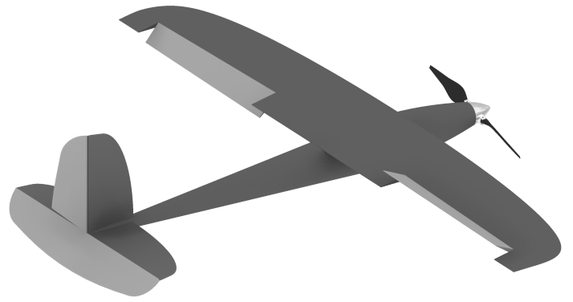
Control Surfaces - Conventional
Ailerons
Elevator
Rudder
Notes:
\delta_a = \frac{1}{2}\left(\delta_{a{\text{-left}}} -
\delta_{a{\text{-right}}}\right)
--
$+\delta_a$ results in positive roll rate $p$
$+\delta_e$ results in negative pitch rate $q$
$+\delta_r$ results in negative yaw rate $r$

Slide 9
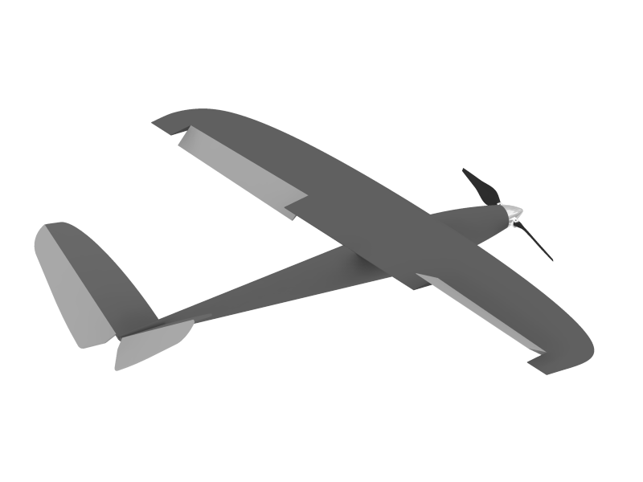
Control Surfaces – V-tail
Ailerons
Ruddervators
Notes:
\begin{pmatrix} \delta_e \\ \delta_r \end{pmatrix} = \frac{1}{2}\begin{pmatrix} 1 & 1 \\ 1 & -1 \end{pmatrix}\begin{pmatrix}\delta_{rr} \\ \delta_{rl} \end{pmatrix}

Slide 10
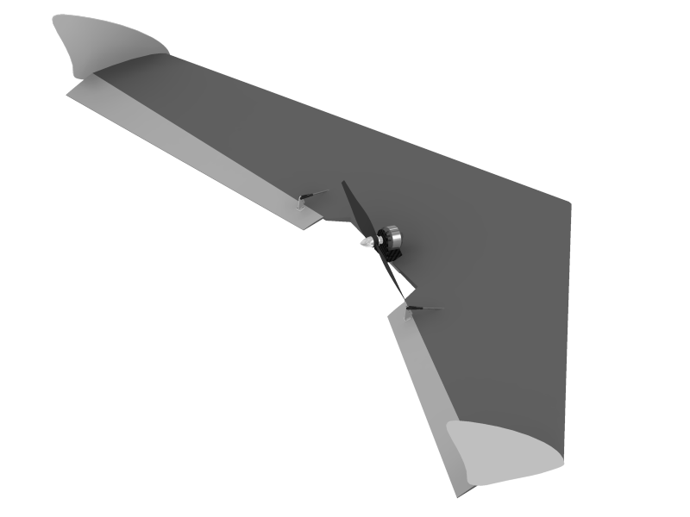
Control Surfaces – Flying Wing
Elevons
Notes:
\begin{pmatrix} \delta_e \\ \delta_a \end{pmatrix} = \frac{1}{2}\begin{pmatrix} 1 & 1 \\ -1 & 1 \end{pmatrix}\begin{pmatrix}\delta_{er} \\ \delta_{el} \end{pmatrix}

Slide 11
Aircraft Dynamics
Aircraft dynamics and aerodynamics are commonly separated into two groups:
Longitudinal
Up-down, pitch plane, pitching motions
Lateral-directional
Side-to-side, turning motions (roll and yaw)

Slide 12
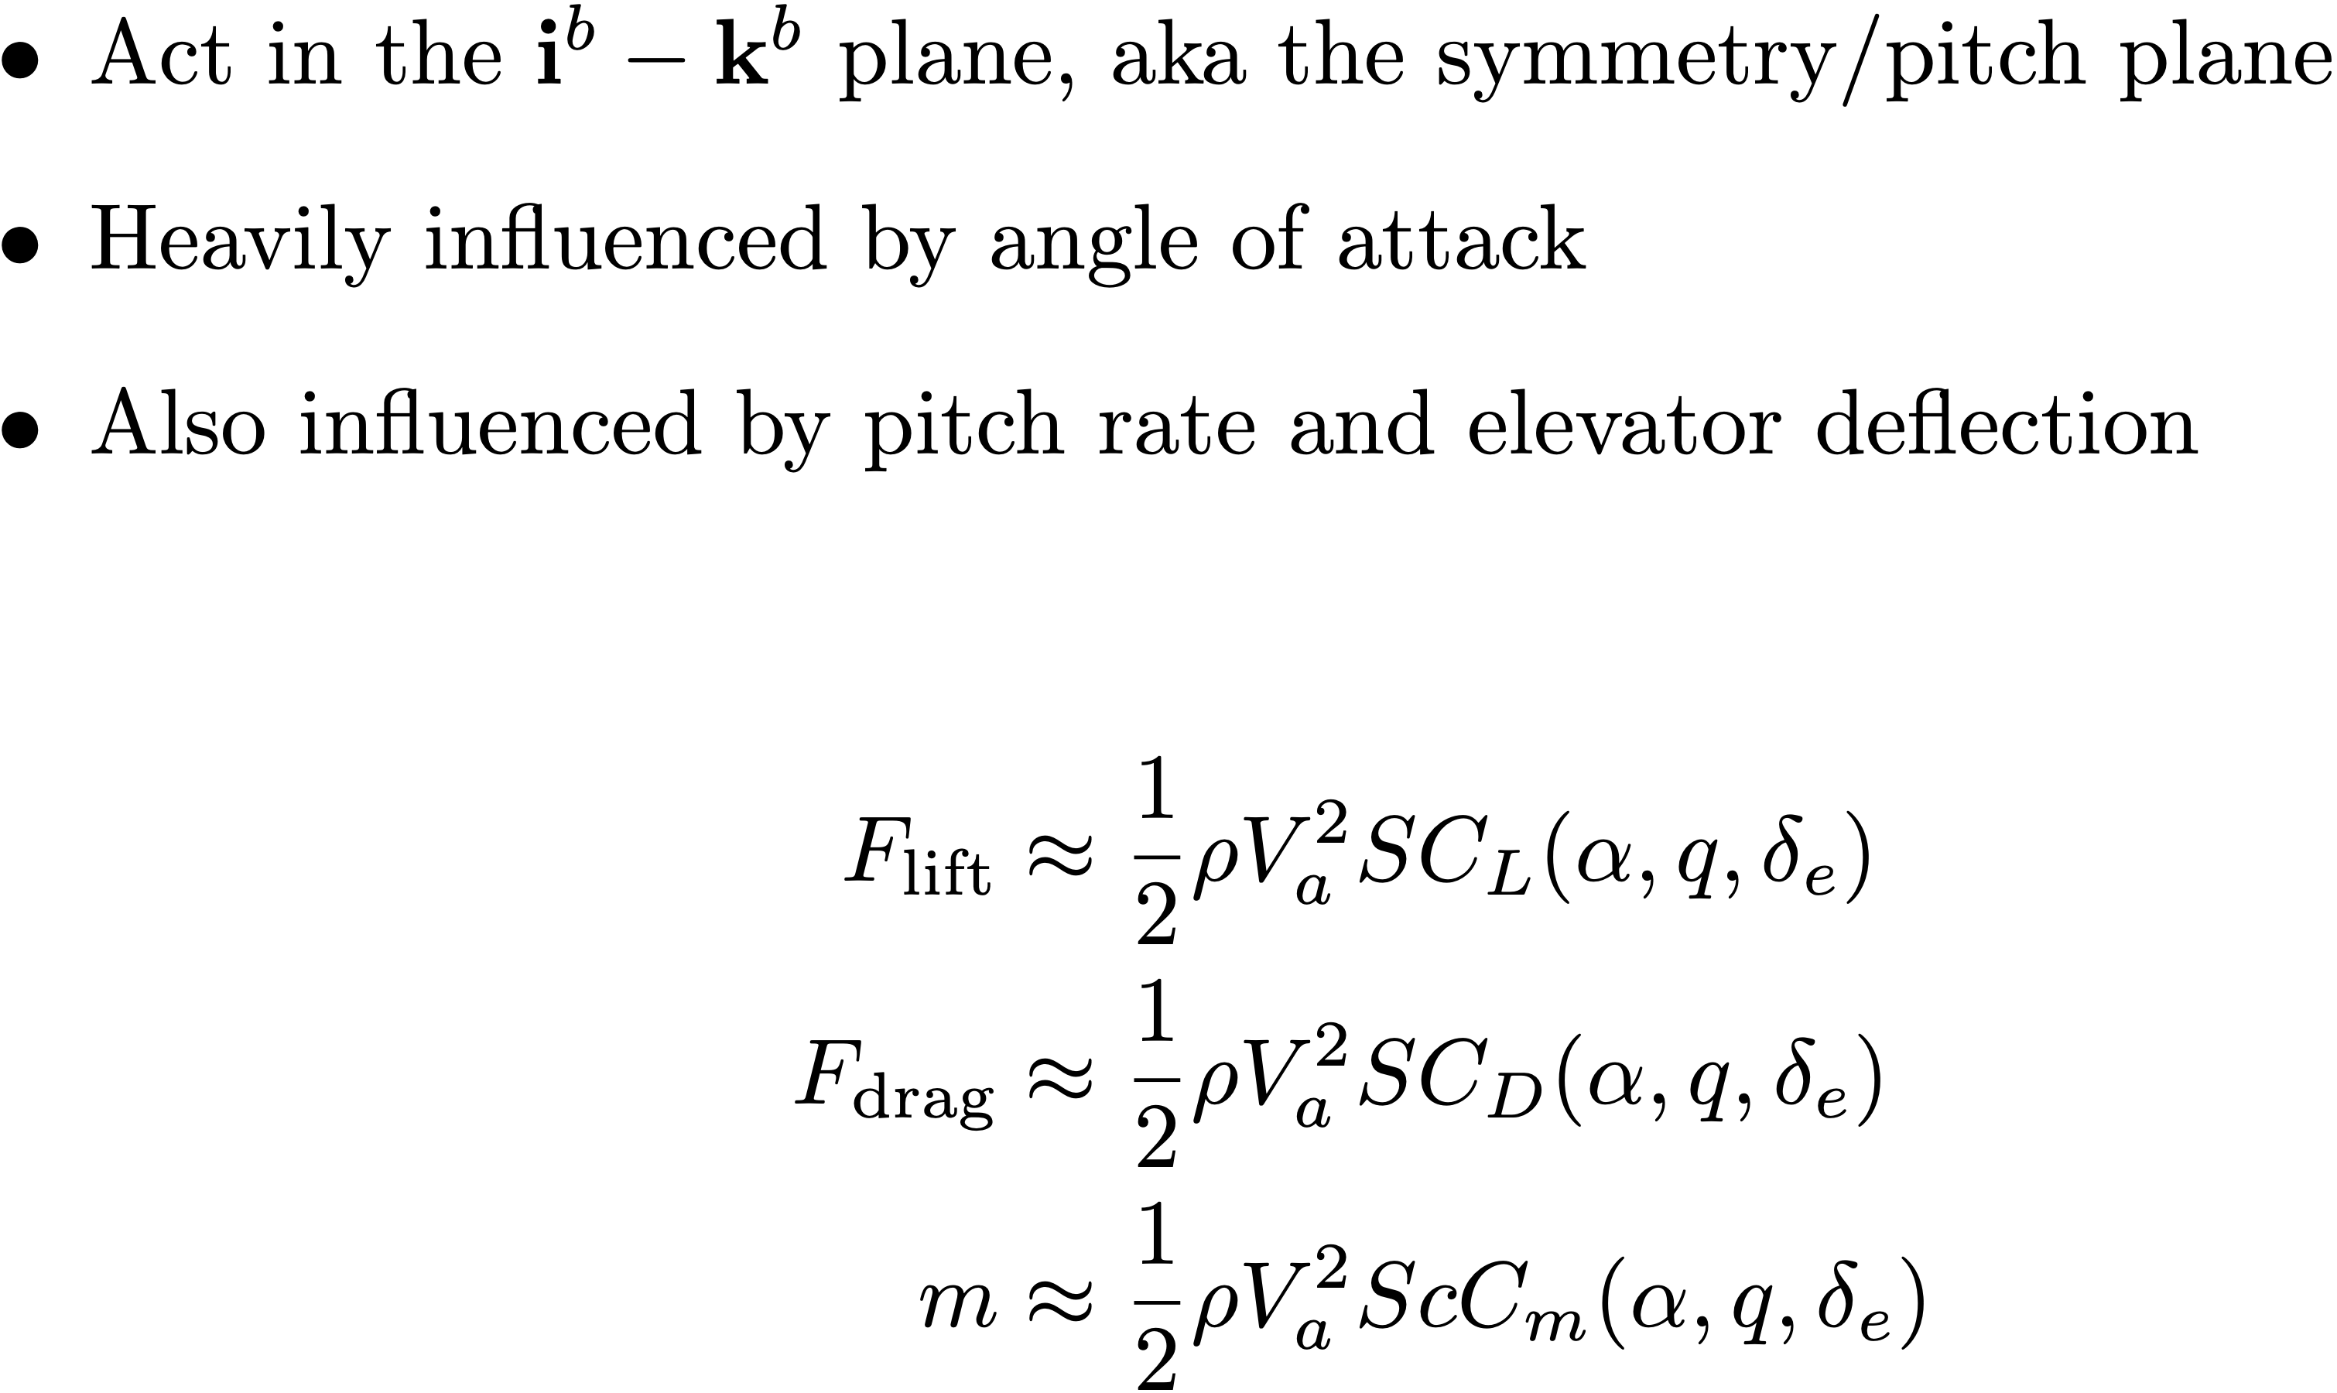
Longitudinal Aerodynamics
Notes:
\begin{itemize}
\item Act in the $\mathbf{i}^b-\mathbf{k}^b$ plane, aka the symmetry/pitch plane
\item Heavily influenced by angle of attack
\item Also influenced by pitch rate and elevator deflection
\end{itemize}
\begin{align*}
F_{\text{lift}} &\approx \frac{1}{2}\rho V_a^2 S C_L (\alpha,q,\delta_e) \\
F_{\text{drag}} &\approx \frac{1}{2}\rho V_a^2 S C_D (\alpha,q,\delta_e) \\
m &\approx \frac{1}{2}\rho V_a^2 S c C_m (\alpha,q,\delta_e)
\end{align*}

Slide 13
Aerodynamic Approximation
stability derivatives
control derivative
Notes:
\newcommand{\pde}[2]{\frac{\partial#1}{\partial#2}}
\newcommand{\defeq}{\stackrel{\triangle}{=}}
\noindent In the general nonlinear case we have
\[
F_{\text{lift}} \approx \frac{1}{2}\rho V_a^2 S C_L (\alpha,q,\delta_e)
\]
Expanding $C_L$ as a Taylor series and keeping only the first-order (linear) terms gives
\begin{align*}
F_{\text{lift}} &= \frac{1}{2}\rho V_a^2 S \left[ C_{L_0} + \pde{C_L}{\alpha}\alpha +
\pde{C_L}{q} q + \pde{C_L}{\delta_e}\delta_e \right] \\
&= \frac{1}{2}\rho V_a^2 S \left[ C_{L_0} + C_{L_{\alpha}}\alpha +
C_{L_{q}}\frac{c}{2V_a}q + C_{L_{\delta_e}}\delta_e \right]
\end{align*}
where the coefficients $C_{L_0}$, $C_{L_\alpha}\defeq\pde{C_L}{\alpha}$, $C_{L_q}\defeq\pde{C_L}{\frac{qc}{2V_a}}$, and $C_{L_{\delta_e}}\defeq\pde{C_L}{\delta_e}$
are dimensionless quantities

Slide 14
Linear Aerodynamic Model
Linear aerodynamic model is valid for small angles of attack – flow remains attached over wing
Notes:
F_{\text{lift}}
&= \frac{1}{2}\rho V_a^2 S \left[ C_{L_0} + C_{L_{\alpha}}\alpha +
C_{L_{q}}\frac{c}{2V_a}q + C_{L_{\delta_e}}\delta_e \right] \\
F_{\text{drag}} &= \frac{1}{2}\rho V_a^2 S \left[ C_{D_0} + C_{D_\alpha} \alpha +
C_{D_{q}}\frac{c}{2V_a}q + C_{D_{\delta_e}}\delta_e
\right] \label{eq:forces-drag-linear}\\
m &= \frac{1}{2}\rho V_a^2 S c \left[ C_{m_0} + C_{m_\alpha} \alpha
+ C_{m_{q}}\frac{c}{2V_a}q + C_{m_{\delta_e}}\delta_e \right]

Slide 15
Nonlinear Aerodynamics – Stall

Slide 16
Nonlinear Lift Model
linear model
nonlinear model
flat-plate model

Slide 17
Nonlinear Aerodynamic Model
linear model
flat-plate model
blending function
Notes:
F_{\textrm{lift}} &= \frac{1}{2}\rho V_a^2 S \left[ C_L(\alpha) +
C_{L_{q}}\frac{c}{2V_a}q + C_{L_{\delta_e}}\delta_e
\right] \label{eq:forces-lift-total}\\
F_{\textrm{drag}} &= \frac{1}{2}\rho V_a^2 S \left[ C_D(\alpha) +
C_{D_{q}}\frac{c}{2V_a}q + C_{D_{\delta_e}}\delta_e
\right]
C_L(\alpha) = \left(1-\sigma(\alpha)\right) \left[C_{L_0} + C_{L_{\alpha}}\alpha \right] + \sigma(\alpha) \left[2\;\text{sign}(\alpha)\sin^2\alpha\cos\alpha \right]
\sigma(\alpha) = \frac{1+e^{-M(\alpha-\alpha_0)}+e^{M(\alpha+\alpha_0)}}{\left(1+e^{-M(\alpha-\alpha_0)}\right)\left(1+e^{M(\alpha+\alpha_0)}\right)}

Slide 18
Blending Function
Notes:
alpha0 = 0.6;
alpha = 0:.01:pi/2;
figure(1), clf, hold on
for M=10:10:50
sig = (1+exp(-M*(alpha-alpha0)) + exp(M*(alpha+alpha0)))...
./((1+exp(-M*(alpha-alpha0))).*(1+exp(M*(alpha+alpha0))));
plot(alpha, sig)
end
legend('M=10', 'M=20', 'M=30', 'M=40', 'M=50', 'fontsize', 18)
xlabel('\alpha', 'fontsize', 24)
title('\sigma(\alpha)', 'fontsize', 24, 'Rotation', 0)
\sigma(\alpha) = \frac{1+e^{-M(\alpha-\alpha_0)}+e^{M(\alpha+\alpha_0)}}{\left(1+e^{-M(\alpha-\alpha_0)}\right)\left(1+e^{M(\alpha+\alpha_0)}\right)}

Slide 19
Nonlinear Aerodynamic Model
Notes:
\noindent The stability derivative
\[
C_{L_{\alpha}} \approx \frac{\pi AR}{1+\sqrt{1+(AR/2)^2}}
\]
represents the sensitivity of lift to the angle of attack, and can be approximated by physical dimensions of the airfoil, where
\begin{description}
\item[$AR\defeq b^2/S$] is the wing aspect ratio
\item[$b$] is the wingspan
\item[$S$] is the wing area
\end{description}

Slide 20
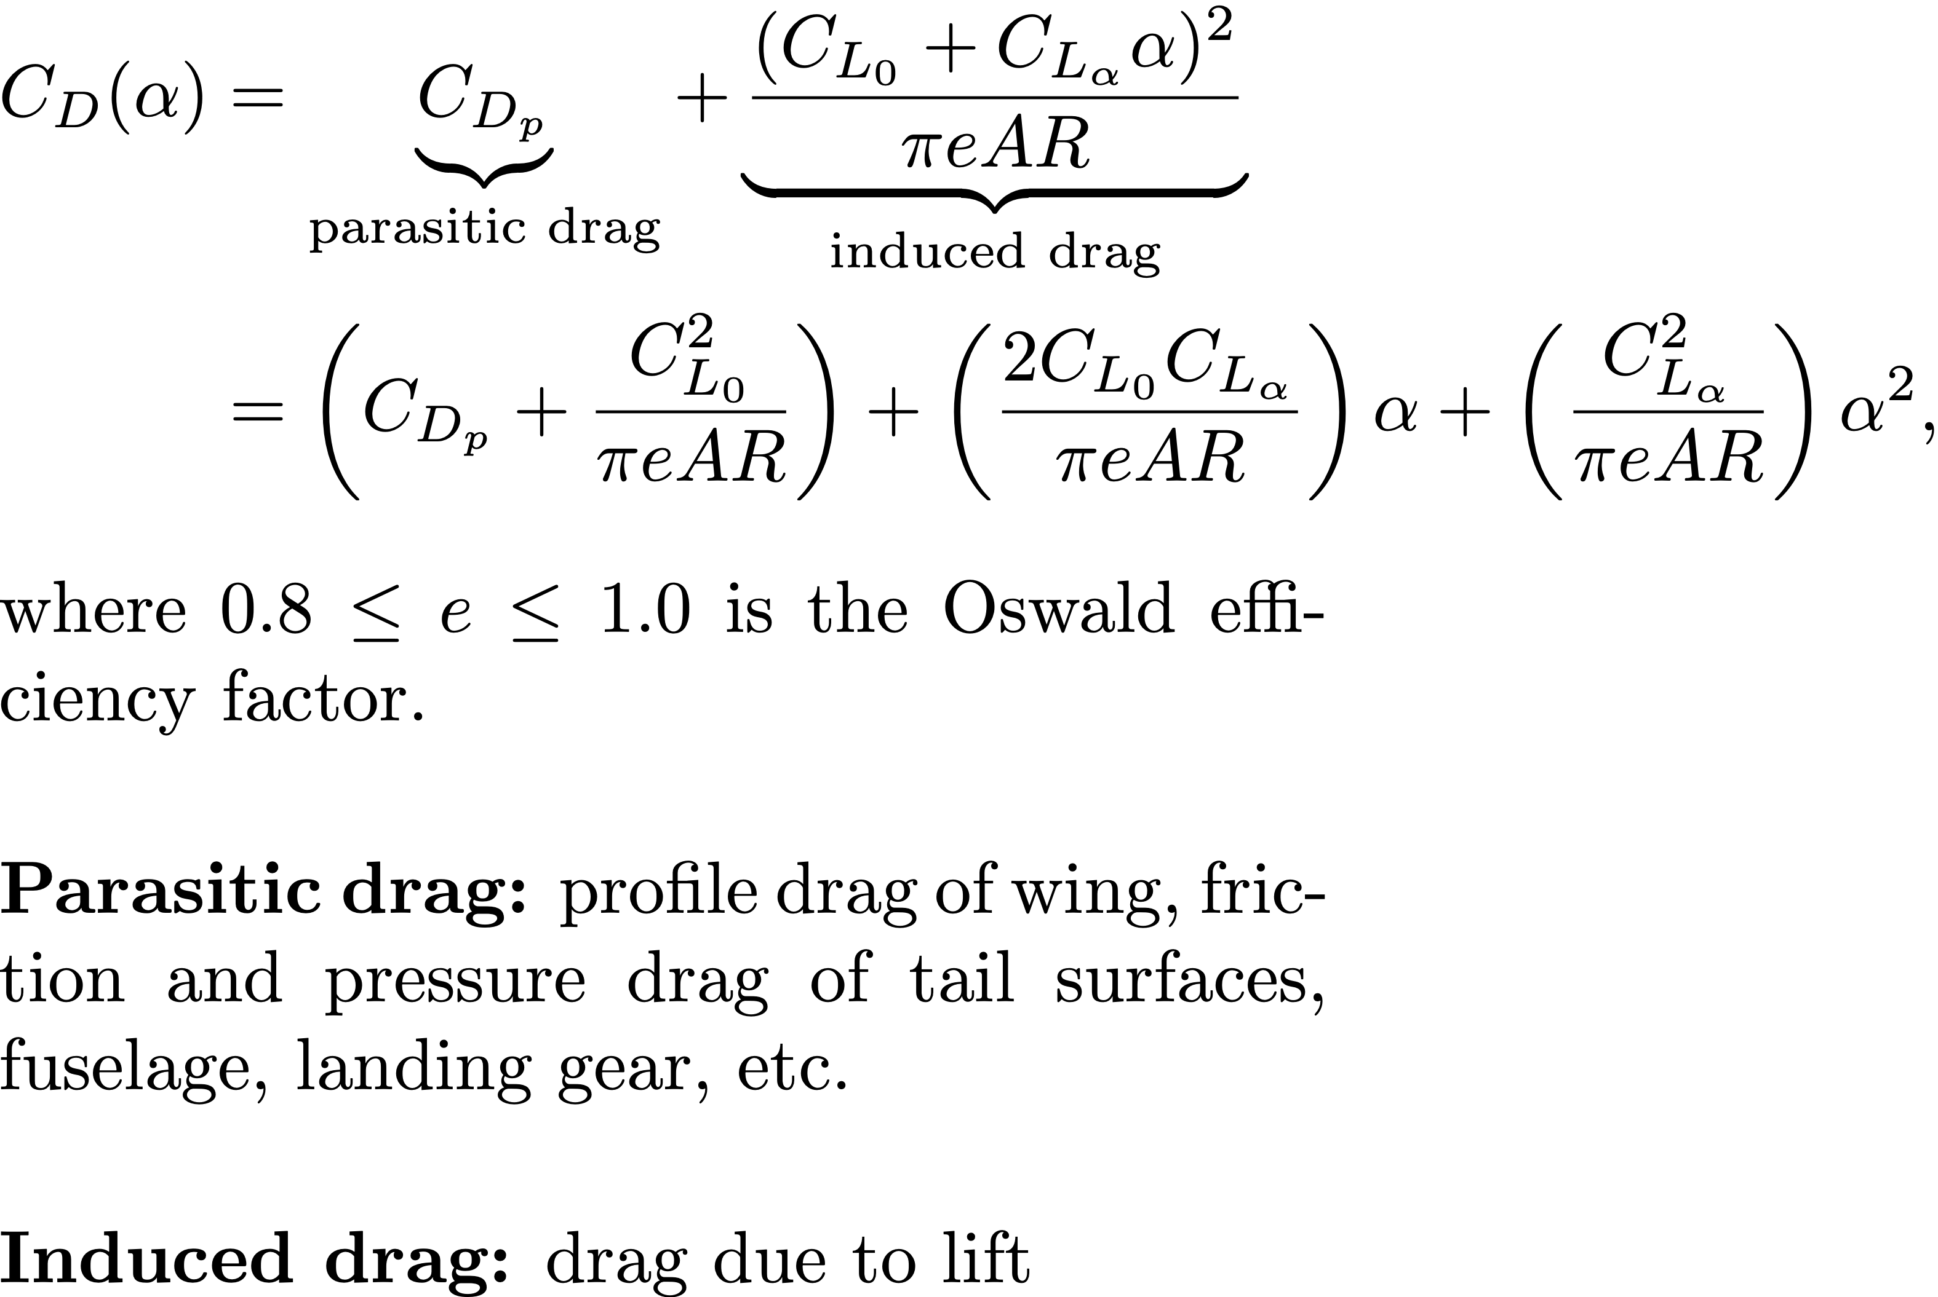
Drag vs. Angle of Attack
linear model incorrect for
negative angles of attack
Notes:
Induced drag intuitive explanations:
Wingtip vortices change surface pressure distributions on wind to increase in direction of drag
Because local relative wind is canted downward due to contributions of wingtip vortices, the lift vector is tilted back and contributes to a force parallel with V_inf that is felt as drag
Wingtip vortices contain certain amount of kinetic energy that must come from somewhere – comes from the propulsion system. Extra power provided is overcoming the induced drag.
----------
\begin{align*}
C_{D}(\alpha) &= \underbrace{C_{D_p}}_{\text{parasitic drag}} + \underbrace{\frac{(C_{L_0} + C_{L_\alpha} \alpha)^2}{\pi e AR}}_{\text{induced drag}} \\
&= \left(C_{D_p} + \frac{C_{L_0}^2}{\pi e AR}\right)
+ \left(\frac{2C_{L_0}C_{L_\alpha}}{\pi e AR}\right)\alpha
+ \left(\frac{C_{L_\alpha}^2}{\pi e AR}\right)\alpha^2,
\end{align*}
where $0.8\leq e \leq 1.0$ is the Oswald efficiency factor.
\vspace{0.5cm}
{\bf Parasitic drag:} profile drag of wing, friction and pressure drag of tail surfaces, fuselage, landing gear, etc.
\vspace{0.5cm}
{\bf Induced drag:} drag due to lift
$e$ is the Oswald efficiency factor

Slide 21
Linear Lift and Drag Models
Notes:
\noindent The linear lift and drag models
\begin{align*}
C_L(\alpha) &\approx C_{L_0} + C_{L_\alpha} \alpha \\
C_D(\alpha) &\approx C_{D_0} + C_{D_\alpha} \alpha
\end{align*}
are valid for small deviations of angle of attack from trim

Slide 22
Longitudinal Forces – Body Frame
Notes:
\begin{pmatrix} f_x \\ f_z \end{pmatrix}
&= \begin{pmatrix}
\cos\alpha & -\sin\alpha \\
\sin\alpha & \cos\alpha
\end{pmatrix}
\begin{pmatrix}
-F_{\textrm{drag}} \\ -F_{\textrm{lift}}
\end{pmatrix} \\
&= \frac{1}{2}\rho V_a^2 S \begin{pmatrix}
\left[ -C_{D}(\alpha)\cos\alpha + C_{L}(\alpha)\sin\alpha \right]
\\ \quad
+\left[ -C_{D_q}\cos\alpha + C_{L_q}\sin\alpha
\right]\frac{c}{2V_a}q
+\left[ -C_{D_{\delta_e}}\cos\alpha + C_{L_{\delta_e}}\sin\alpha \right] \delta_e
\\
---
\\
\left[ -C_{D}(\alpha)\sin\alpha - C_{L}(\alpha)\cos\alpha \right]
\\\quad
+\left[ -C_{D_q}\sin\alpha - C_{L_q}\cos\alpha
\right]\frac{c}{2V_a}q
+\left[ -C_{D_{\delta_e}}\sin\alpha - C_{L_{\delta_e}}\cos\alpha \right] \delta_e
\end{pmatrix}

Slide 23
Pitching Moment
Notes:
\[
m = \frac{1}{2}\rho V_a^2 S c \left[ C_{m_0} + C_{m_\alpha} \alpha
+ C_{m_{q}}\frac{c}{2V_a}q + C_{m_{\delta_e}}\delta_e \right]
\]
\vspace{0.5cm}
\begin{itemize}
\item Uses linear model
\item No rotation transformation necessary
\end{itemize}

Slide 24
Lateral Aerodynamics
Notes:
f_y &= \frac{1}{2}\rho V_a^2 S C_{Y}(\beta, p, r, \delta_a, \delta_r) \\
l &= \frac{1}{2}\rho V_a^2 S b C_{l}(\beta, p, r, \delta_a, \delta_r) \\
n &= \frac{1}{2}\rho V_a^2 S b C_{n}(\beta, p, r, \delta_a, \delta_r)

Slide 25
Aerodynamic Coefficients
Static stability derivatives describe spring behavior of aerodynamics
Notes:
\noindent
$C_{m_{\alpha}}$, $C_{\ell_{\beta}}$, $C_{n_\beta}$, $C_{m_q}$, $C_{\ell_p}$, $C_{n_r}$ are called the {\em stability derivatives} because their values determine the stability of the aircraft.
\vspace{0.75cm}
\underline{Static Stability Derivatives}
\begin{itemize}
\item $C_{m_{\alpha}}$ - longitudinal static stability derivative. Must be $\leq 0$ for stability: increase in $\alpha$ causes and downward pitching moment.
\item $C_{\ell_\beta}$ - roll static stability derivative. Associated with dihedral in wings. Must be $\leq 0$ for stability: positive roll $\phi$ causes a restoring moment.
\item $C_{n_\beta}$ - yaw static stability derivative. Weathercock stability derivative. Influenced by design of tail. Causes airframe to align with the wind vector. Must be $\geq 0$ for stability: cocks airframe into wind driving $\beta$ to zero.
\end{itemize}

Slide 26
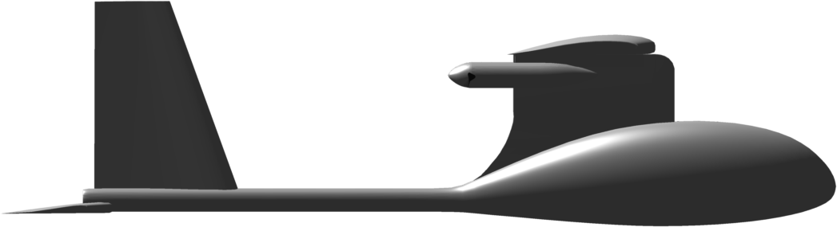
Longitudinal Static Stability Derivative
Notes:
\noindent An aircraft is longitudinally statically stable if the pitching moment about the center of mass restores the aircraft to its trim angle of attack whenever it is perturbed away from trim. For this to be true, the pitching moment is positive when the angle of attack is zero ($C_{m_0}>0$) and the pitching moment decreases as the angle of attack increases ($C_{m_\alpha}<0$). Note that the pitching moment is zero at the trim condition ($\alpha = \alpha_0$).

Slide 27
Roll Static Stability Derivative
(view from the tail)
Notes:
\noindent
Given the wing dihedral, a roll angle of $\phi$ will cause a side velocity $v$, which induces a side slip angle $\beta$, which increases the lift on the leading wing, and decreases the lift on the trailing wing, causing a negative rolling moment. Hence the dihedral angle causes $C_{\ell_\beta}<0$.

Slide 28
Yaw Static Stability Derivative
Notes:
\noindent
For a positive side slip angle $\beta$, the change in lift on the tail creates a moment about the center of mass, that pushes the nose toward the direction of the wind, or in other words, creates a positive yawing moment $n$. Hence $C_{n_\beta}>0$.

Slide 29
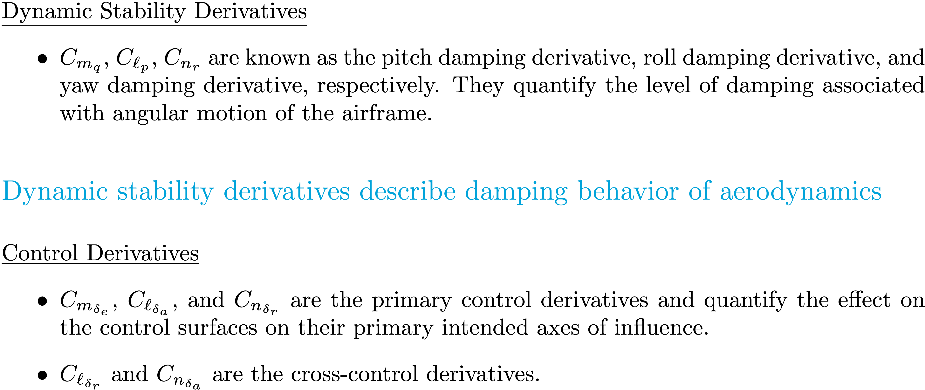
Aerodynamic Coefficients
Notes:
Q: If we linearize the equations of motion to be in the form xdot = Ax + Bu, where do the stability derivatives show up? Control derivatives?
----------------------
\underline{Dynamic Stability Derivatives}
\begin{itemize}
\item $C_{m_q}$, $C_{\ell_p}$, $C_{n_r}$ are known as the pitch damping derivative, roll damping derivative, and yaw damping derivative, respectively. They quantify the level of damping associated with angular motion of the airframe.
\end{itemize}
\vspace{0.5cm}
{\color{cyan} \large Dynamic stability derivatives describe damping behavior of aerodynamics}
\vspace{0.5cm}
\underline{Control Derivatives}
\begin{itemize}
\item $C_{m_{\delta_e}}$, $C_{\ell_{\delta_a}}$, and $C_{n_{\delta_r}}$ are the primary control derivatives and quantify the effect on the control surfaces on their primary intended axes of influence.
\item $C_{\ell_{\delta_r}}$ and $C_{n_{\delta_a}}$ are the cross-control derivatives.
\end{itemize}

Slide 30
Propeller Thrust and Torque
Notes:
\par\noindent If the propeller shaft is aligned along the body frame $\mathbf{i}^b$ axis, then the resulting force and torque are given by
\begin{align*}
\mathbf{f}^b &= \begin{pmatrix} T_p \\ 0 \\ 0 \end{pmatrix} \\
\mathbf{m}^b &= \begin{pmatrix} Q_p \\ 0 \\ 0 \end{pmatrix}
\end{align*}

Slide 31
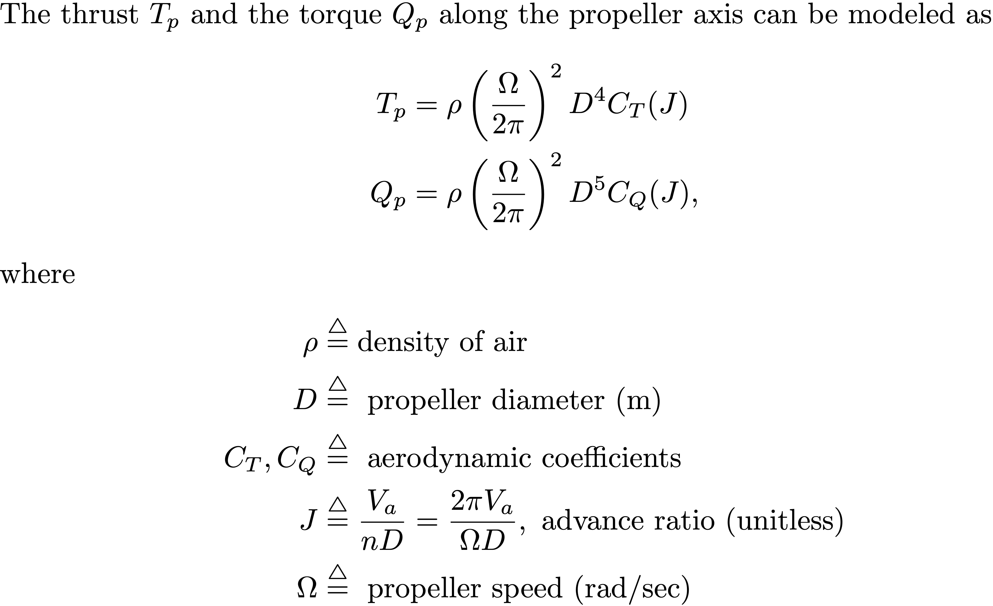
Propeller Thrust and Torque
Notes:
\par\noindent The thrust $T_p$ and the torque $Q_p$ along the propeller axis can be modeled as
\begin{align*}
T_p &= \rho \left(\frac{\Omega}{2\pi}\right)^2 D^4 C_T(J) \\
Q_p &= \rho \left(\frac{\Omega}{2\pi}\right)^2 D^5 C_Q(J),
\end{align*}
where
\begin{align*}
\rho &\stackrel{\triangle}{=} \text{density of air} \\
D &\stackrel{\triangle}{=} \text{~propeller diameter (m)} \\
C_T, C_Q &\stackrel{\triangle}{=} \text{~aerodynamic coefficients} \\
J &\stackrel{\triangle}{=} \frac{V_a}{nD} = \frac{2\pi V_a}{\Omega D}, \text{~advance ratio (unitless)} \\
\Omega &\stackrel{\triangle}{=} \text{~propeller speed (rad/sec)} \\
\end{align*}

Slide 32
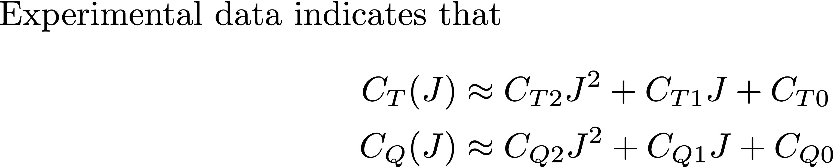
Propeller Thrust and Torque
Notes:
\par\noindent Experimental data indicates that
\begin{align*}
C_T ( J ) &\approx C_{T2} J^2 + C_{T1} J + C_{T0} \\
C_Q ( J ) &\approx C_{Q2} J^2 + C_{Q1} J + C_{Q0} \\
\end{align*}

Slide 33
Propeller Thrust and Torque
Notes:
\par\noindent For a DC motor, the steady-state torque generated for a given input voltage $V_{in}$ is given by
\[
\label{eq:motor_torque}
Q_m = K_Q\left[ \frac{1}{R}\left(V_{in} - K_V \Omega \right) - i_0 \right],
\]
where
\begin{align*}
R &\stackrel{\triangle}{=} \text{~resistance of the motor windings} \\
K_Q &\stackrel{\triangle}{=} \text{~motor torque constant} \\
K_V &\stackrel{\triangle}{=} \text{~back-emf voltage constant} \\
i_0 &\stackrel{\triangle}{=} \text{~zero-torque or no-load current}
\end{align*}
\noindent
In our case, $V_{in} = V_{max} \delta_t$ where $\delta_t \in [0,1]$ and $V_{max}$ is the maximum \\ battery voltage

Slide 34
Propeller Thrust and Torque
Notes:
Draw the two torque curves – show their intersection as the operating speed.
\noindent For a given voltage input to our motor, we want to know the propeller speed and how much thrust the propeller produces. This will depend on the airspeed of the aircraft (and other things). \\
\noindent Propeller torque can be expressed as a function of propeller speed as:
\[
Q_p(\Omega_p, C_Q) = \frac{\rho D^5}{4\pi^2}\Omega_p^2 C_Q
\]
\noindent Motor torque can also be expressed as a function of motor speed:
\[
Q_m = K_Q\left[ \frac{1}{R}\left(V_{in} - K_V \Omega \right) - i_0 \right],
\]
\noindent We know that the propeller torque and the motor torque are equivalent (they are connected by a shaft that we are assuming is rigid), so we can find the operating speed of the motor/prop combination by equating the torque expressions above and solving for $\Omega = \Omega_p$.

Slide 35
Propeller Thrust and Torque
Notes:
\par\noindent In equilibrium, the motor torque and the propeller torque are equal. Setting $Q_p=Q_m$ gives
\[
\left(\frac{\rho D^5}{(2\pi)^2}C_{Q0}\right) \Omega^2 +
\left( \frac{\rho D^4}{2\pi}C_{Q1} V_a +\frac{K_Q K_V}{R} \right) \Omega %\\ &
+ \left( \rho D^3 C_{Q2} V_a^2 - \frac{K_Q}{R} V_{in} + K_Q i_0 \right) = 0
\]
Solving for the positive root gives the operating propeller speed
\begin{equation*}
\Omega_{\text{op}} = \frac{-b+\sqrt{b^2-4ac}}{2a}
\end{equation*}
where
\begin{align*}
a &= \frac{\rho D^5}{(2\pi)^2}C_{Q0} \\
b &= \frac{\rho D^4}{2\pi}C_{Q1} V_a +\frac{K_Q K_V}{R} \\
c &= \rho D^3 C_{Q2} V_a^2 - \frac{K_Q}{R} V_{in} + K_Q i_0
\end{align*}
The associated advance ratio is
\[
J_\text{op} = \frac{2\pi V_a}{\Omega_\text{op} D}
\]

Slide 36
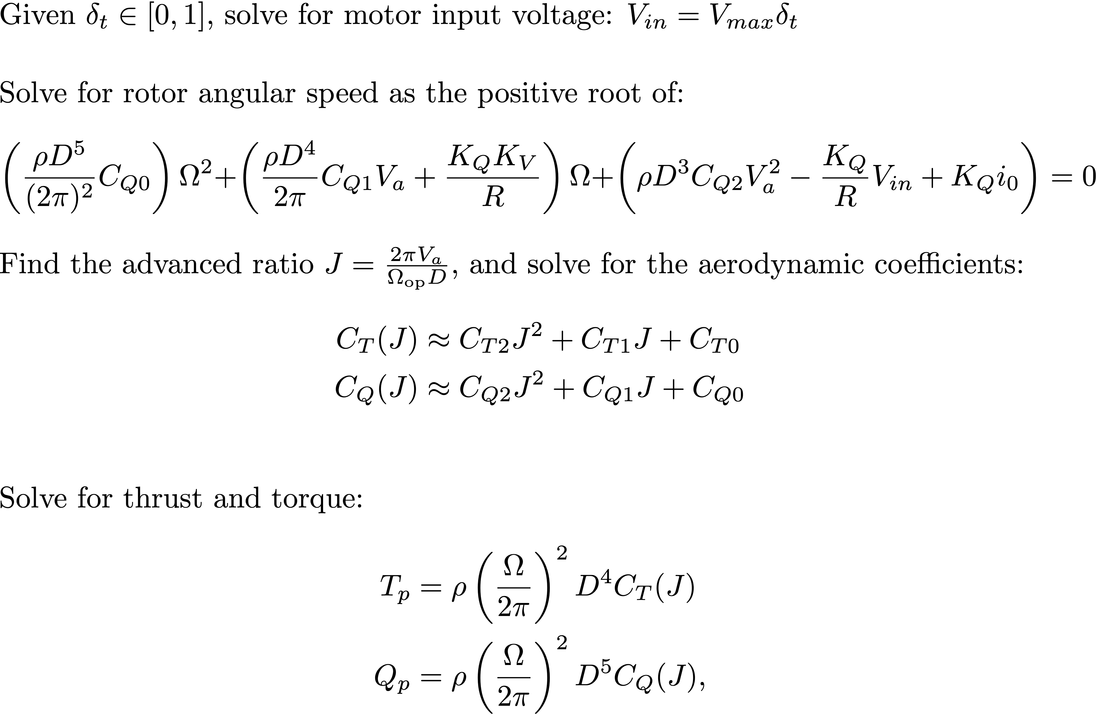
Propeller Thrust and Torque: Summary
Notes:
Given $\delta_t\in[0,1]$, solve for motor input voltage: $V_{in} = V_{max}\delta_t$
\vspace{0.5cm}
Solve for rotor angular speed as the positive root of:
\[
\left(\frac{\rho D^5}{(2\pi)^2}C_{Q0}\right) \Omega^2 +
\left( \frac{\rho D^4}{2\pi}C_{Q1} V_a +\frac{K_Q K_V}{R} \right) \Omega %\\ &
+ \left( \rho D^3 C_{Q2} V_a^2 - \frac{K_Q}{R} V_{in} + K_Q i_0 \right) = 0
\]
Find the advanced ratio $J=\frac{2\pi V_a}{\Omega_\text{op} D}$, and solve for the aerodynamic coefficients:
\begin{align*}
C_T ( J ) &\approx C_{T2} J^2 + C_{T1} J + C_{T0} \\
C_Q ( J ) &\approx C_{Q2} J^2 + C_{Q1} J + C_{Q0} \\
\end{align*}
Solve for thrust and torque:
\begin{align*}
T_p &= \rho \left(\frac{\Omega}{2\pi}\right)^2 D^4 C_T(J) \\
Q_p &= \rho \left(\frac{\Omega}{2\pi}\right)^2 D^5 C_Q(J),
\end{align*}

Slide 37
Propeller Thrust and Torque
Notes:
\begin{lstlisting}[language=python]
# compute thrust and torque due to propeller (See addendum by McLain)
# map delta_t throttle command(0 to 1) into motor input voltage
V_in = MAV.V_max * delta_t
# Quadratic formula to solve for motor speed
a = MAV.C_Q0 * MAV.rho * np.power(MAV.D_prop, 5) \
/ ((2.*np.pi)**2)
b = (MAV.C_Q1 * MAV.rho * np.power(MAV.D_prop, 4)
/ (2.*np.pi)) * self._Va + KQ**2/MAV.R_motor
c = MAV.C_Q2 * MAV.rho * np.power(MAV.D_prop, 3) \
* self._Va**2 - (KQ / MAV.R_motor) * Volts + KQ * MAV.i0
# Consider only positive root
Omega_op = (-b + np.sqrt(b**2 - 4*a*c)) / (2.*a)
# compute advance ratio
J_op = 2 * np.pi * self._Va / (Omega_op * MAV.D_prop)
# compute non-dimensionalized coefficients of thrust and torque
C_T = MAV.C_T2 * J_op**2 + MAV.C_T1 * J_op + MAV.C_T0
C_Q = MAV.C_Q2 * J_op**2 + MAV.C_Q1 * J_op + MAV.C_Q0
# add thrust and torque due to propeller
n = Omega_op / (2 * np.pi)
fx += MAV.rho * n**2 * np.power(MAV.D_prop, 4) * C_T
Mx += -MAV.rho * n**2 * np.power(MAV.D_prop, 5) * C_Q
\end{lstlisting}

Slide 38
Wind Model
Notes:
From the wind triangle we have
\[
\mathbf{V}_g = \mathbf{V}_a + \mathbf{V}_w.
\]
The wind vector can be decomposed into steady state and gust components:
\[
\mathbf{V}_w = \mathbf{V}_{w_s} + \mathbf{V}_{w_g}.
\]
The steady state component is typically expressed in the NED frame:
\[
\mathbf{V}_{w_s}^i = \begin{pmatrix} w_{n_s} \\ w_{e_s} \\ w_{d_s} \end{pmatrix}.
\]
The gust component is typically expressed in the body frame:
\[
\mathbf{V}_{w_g}^b = \begin{pmatrix} u_{w_g} \\ v_{w_g} \\ w_{w_g} \end{pmatrix}.
\]

Slide 39
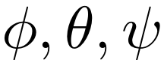
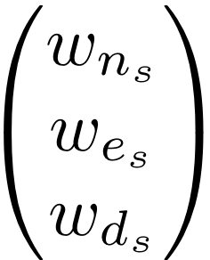
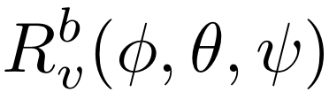

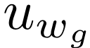
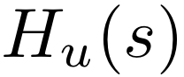
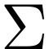
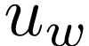
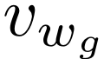
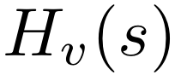
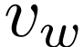
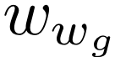
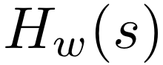
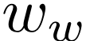
Wind Model

Slide 40
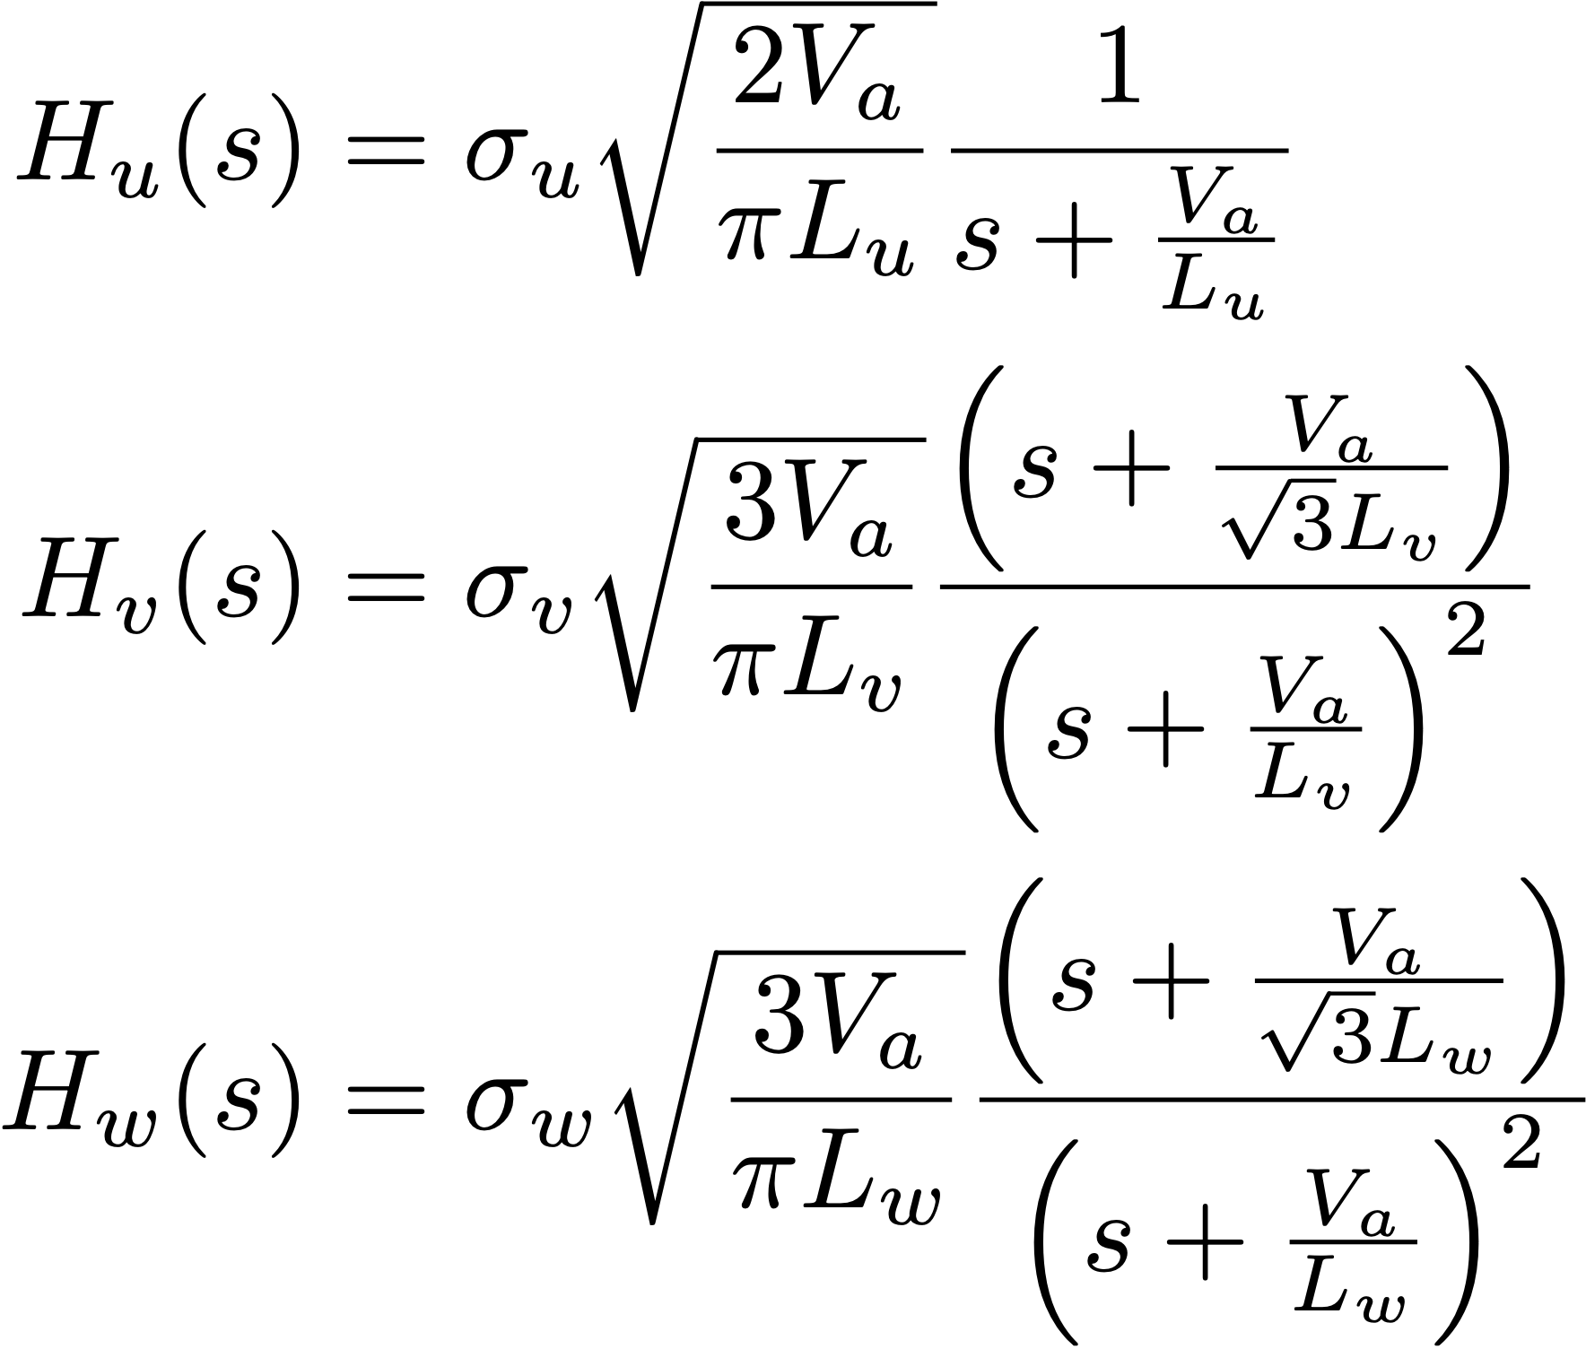
Dryden Gust Model
Notes:
H_{u}(s) &= \sigma_{u}\sqrt{\frac{2V_a}{\pi L_{u}}}\frac{1}{s+\frac{V_a}{L_{u}}} \\
H_{v}(s) &= \sigma_{v}\sqrt{\frac{3V_a}{\pi L_{v}}}\frac{\left(s+\frac{V_a}{\sqrt{3}L_{v}}\right)}{\left(s+\frac{V_a}{L_{v}}\right)^2} \\
H_{w}(s) &= \sigma_{w}\sqrt{\frac{3V_a}{\pi L_{w}}}\frac{\left(s+\frac{V_a}{\sqrt{3}L_{w}}\right)}{\left(s+\frac{V_a}{L_{w}}\right)^2}

Slide 41
Transfer Function Implementation
Notes:
\noindent
To implement the system
\[
Y(s) = \frac{as+b}{s^2+cs+d}U(s),
\]
first put the system into control canonical form
\begin{align*}
\dot{x} &= \begin{pmatrix}-c & -d \\ 1 & 0 \end{pmatrix}x + \begin{pmatrix} 1 \\ 0\end{pmatrix}u\\
y&=\begin{pmatrix} a & b \end{pmatrix} x,
\end{align*}
and then convert to discrete time using
\begin{align*}
x_{k+1} &= x_k + T_s(Ax_k + Bu_k) \\
y_k &= Cx_k
\end{align*}
where $T_s$ is the sample rate, to get
\begin{align*}
x_{k+1} &= \begin{pmatrix}1-T_sc & -T_sd \\ T_s & 1 \end{pmatrix}x_k + \begin{pmatrix} T_s \\ 0\end{pmatrix}u_k\\
y_k &= \begin{pmatrix} a & b \end{pmatrix} x_k.
\end{align*}
For the Dryden model gust models, the input $u_k$ will be zero mean Gaussian noise with unity variance.

Slide 42
Adding in the Effects of Wind
Key concept:
Wind and turbulence affect airspeed, angle of attack, and sideslip angle
It is through these parameters that wind and atmospheric effects enter the calculation of aerodynamic forces and moments, and thereby affect motion of aircraft

Slide 43
Summary
Notes:
\newcommand{\mass}{\mathsf{m}}
\begin{align*}
\begin{pmatrix} f_x \\ f_y \\ f_z \end{pmatrix}
= \begin{pmatrix}
-\mass g\sin\theta \\ \mass g\cos\theta\sin\phi \\ \mass g\cos\theta\cos\phi
\end{pmatrix}
&+ \frac{1}{2}\rho V_a^2 S \begin{pmatrix}
C_{X}(\alpha)
+ C_{X_{q}}(\alpha) \frac{c}{2V_a}q \\
C_{Y_0}
+ C_{Y_{\beta}} \beta
+ C_{Y_p} \frac{b}{2V_a}p
+ C_{Y_r} \frac{b}{2V_a}r \\
C_{Z}(\alpha)
+ C_{Z_q}(\alpha) \frac{c}{2V_a}q
\end{pmatrix}
\\
&+ \frac{1}{2}\rho V_a^2 S \begin{pmatrix}
C_{X_{\delta_e}}(\alpha) \delta_e \\
C_{Y_{\delta_a}} \delta_a + C_{Y_{\delta_r}} \delta_r \\
C_{Z_{\delta_e}}(\alpha) \delta_e
\end{pmatrix}
+ \begin{pmatrix}
T_p(\delta_t V_a) \\ 0 \\ 0
\end{pmatrix}
\end{align*}

Slide 44
Project 4
Notes:
\begin{enumerate}
\item Add simulation of the wind to the mavsim simulator. The wind element should produce wind gust along the body axes, and steady state wind along the NED inertial axes.
\item Add forces and moments to the dynamics of the MAV. The inputs to the MAV should now be elevator, throttle, aileron, and rudder. The aerodynamic coefficients are given in Appendix~\ref{chap:parameters}.
\item Verify your simulation by setting the control surface deflections to different values. Observe the response of the MAV. Does it behave
as you think it should?
\end{enumerate}

